Slide 1


HAND WRITTEN DIGIT RECOGINITION
WITH CNN
BY: DAYANA DEVI K

Slide 2
NAME : DAYANA DEVI K DEPARTMENT : B TECH INFORMATION TECHNOLOGY COLLEGE NAME : MEENAKSHI SUNDARARAJAN ENGINEERING COLLEGE GMAIL ID : dayanadevikuppan4@gmail.com NM ID: 23C5C111FF87AFF81544AEE85B078B29 Zone III : Chennai-III

Slide 3
AGENDA
PROBLEM STATEMENT
PROJECT
OVERVIEW
1
2
3
CNN AND ITS
LAYERS
(algorithm)
WHO ARE THE
END USERS
5
SOLUTION AND ITS VALUE PROPOSITION
THE WOW IN MY SOLUTION
4
6
MODELLING
8
9
RESULTS
7
CODE IMPLEMENTATION

Slide 4
PROBLEM STATEMENT
To Develop a deep learning model to accurately classify handwritten digits from the MNIST dataset using convolutional neural networks (CNNs). The model should be trained to recognize digits ranging from 0 to 9 and achieve high accuracy in classifying unseen handwritten digits. In today's world, there's a big need for computers to understand handwritten numbers. Think about when we write a check or fill out a form – wouldn't it be helpful if a computer could easily read what we wrote? The goal is to make this system really good at recognizing all sorts of handwriting, so it can be useful in things like sorting mail, processing checks, and filling out forms automatically.

Slide 5

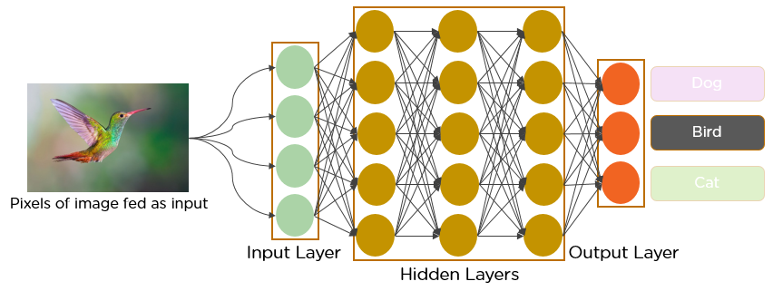
Convolutional Neural Network (Algorithm used)
CNN is a deep learning technique to classify the input automatically (well, after you provide the right data).
Over the years, CNN has found a good grip over classifying images for computer visions and now it is being used in healthcare domains too.
This indicates that CNN is a reliable deep learning algorithm for an automated end-to-end prediction.
CNN essentially extracts ‘useful’ features from the given input automatically making it super easy for us!

Slide 6
THREE LAYERS OF CNN
Convolutional Layer
Pooling Layer
Fully-Connected Layer
This layer extracts high-level input features from input data and passes those features to the next layer in the form of feature maps.
It is used to reduce the dimensions of data by applying pooling on the feature map to generate new feature maps with reduced dimensions. PL takes either maximum or average in the old feature map within a given stride.
Finally, the task of classification is done by the FC layer. Probability scores are calculated for each class label by a popular activation function called the softmax function.

Slide 7

PROJECT OVERVIEW
4.TRAIN THE MODEL
1.DATA PREPARATION
2.MODEL
ARCHITECTURE
5.EVALUATE THE MODEL
6.MAKE PREDICTIONS
3.MODEL
COMPILATION

Slide 8
WHO ARE END USERS ?
INDIVIDUALS
INSTITUTIONS
needing to input handwritten digits into digital systems.
for grading and analyzing student work.
END USERS
BUISNESS
GOVERNMENT
across various industries for automating data entry.
agencies for processing forms and documents.

Slide 9
SOLUTION AND ITS VALUE PROPOSITION
The system accurately identifies handwritten digits, providing reliable results for various applications.
01
Accuracy
It streamlines digit recognition processes, saving time and effort compared to manual entry or processing methods.
02
Efficiency
By automating the recognition process, it reduces the need for manual intervention, improving workflow efficiency.
03
Automation

Slide 10
YOUR SOLUTION AND ITS VALUE PROPOSITION (CONTD)
The system can handle large volumes of handwritten digits, making it suitable for both small-scale and large-scale applications.
04
Scalability
It can be integrated into diverse systems and applications across different industries, offering flexibility and adaptability.
05
Versatility
By reducing the need for manual labor and minimizing errors, it contributes to cost savings over time.
06
Cost-effectiveness

Slide 11
THE WOW IN MY SOLUTION
WOW FACTORS
40% | 100%
INITIAL MODEL TRAINING | PROVIDE VALUES
Impress with early results of your CNN model trained on a subset of the MNIST dataset, demonstrating its ability to learn and make predictions even in the early stages | Its user-friendly interface, scalability, and cost-effectiveness, our solution delivers unparalleled value by streamlining processes and optimizing workflow.

Slide 12
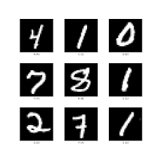
MODELLING
1 .Data Preparation:
The MNIST dataset consists of grayscale images of handwritten digits from 0 to 9.
Each image is 28 Load the MNIST dataset, which consists of grayscale images of handwritten digits and their corresponding labels.
Normalize the pixel values to the range [0, 1].
Reshape the input data to have a single channel. x28 pixels.

Slide 13
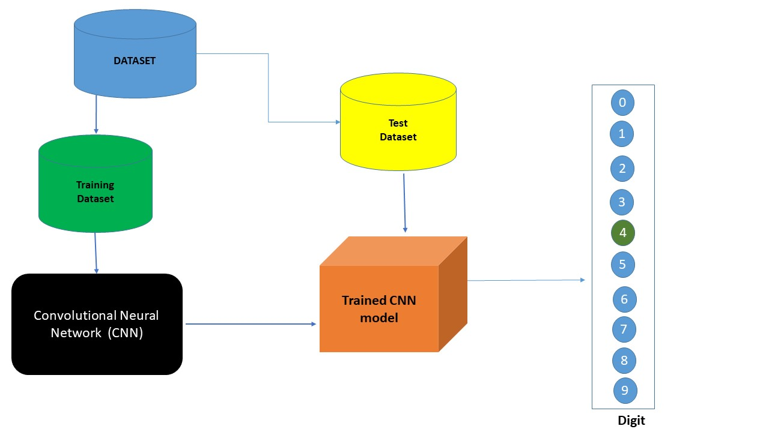
2. Model Architecture :
We design a CNN architecture for the digit recognition task.
This typically involves stacking convolutional layers followed by pooling layers to extract relevant features from the images, flattening the output, and then passing it through fully connected layers for classification

Slide 14
3. Compile Model: Once the architecture is defined, we compile the model with appropriate loss function (usually categorical cross-entropy for multi-class classification), optimizer (commonly Adam), and evaluation metric (accuracy).
4. Training: We train the model on the training data, adjusting the weights using backpropagation and optimization algorithms to minimize the loss function. This step involves iterating through the training data for multiple epochs.
5. Evaluation: After training, we evaluate the model's performance on a separate test dataset to assess its accuracy and generalization ability.
6. Prediction: Finally, we can use the trained model to make predictions on new, unseen handwritten digit images. The model predicts the digit represented by the input image.

Slide 15
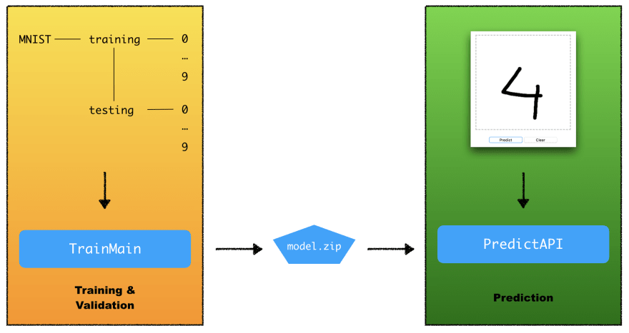

Slide 16
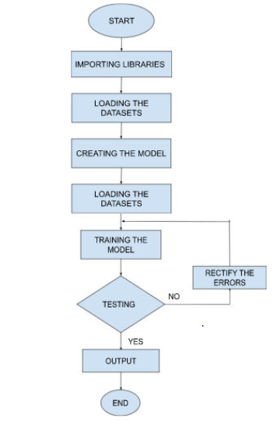
FLOW CHART

Slide 17
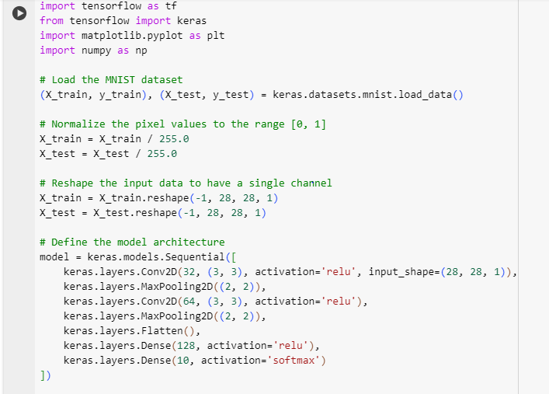
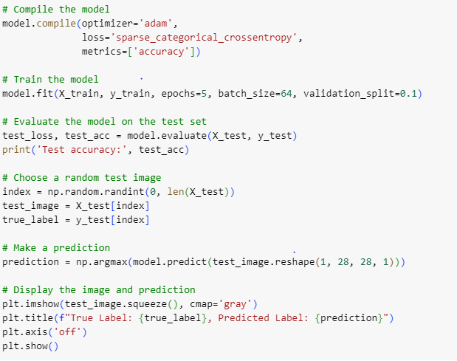
CODE IMPLEMENTATION

Slide 18
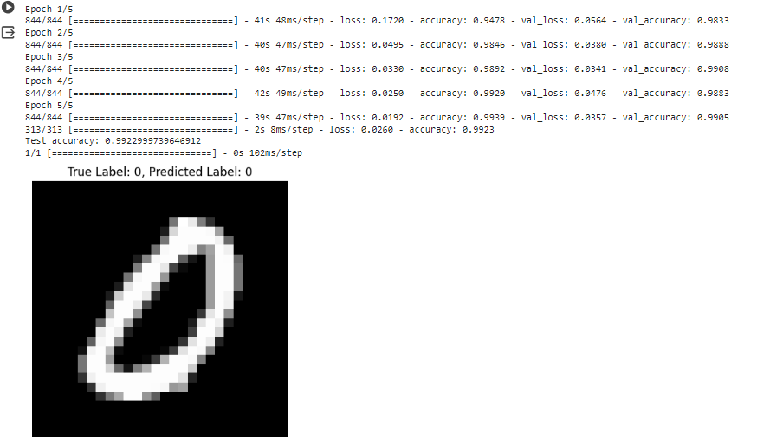
RESULTS
TRUE LABEL :0
PREDICTED LABEL:0

Slide 19
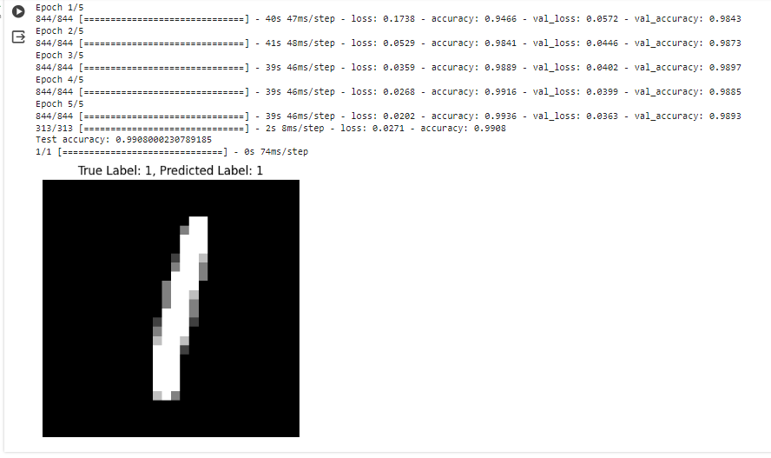
RESULTS (CONTD)
TRUE LABEL :1
PREDICTED LABEL:1

Slide 20
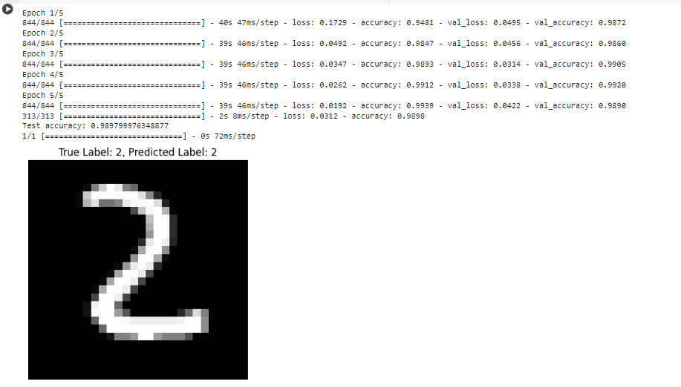
RESULTS (CONTD)
TRUE LABEL :2
PREDICTED LABEL:2

Slide 21
SUMMARY OF RESULTS
Model Training And Model Evaluation : The model is trained for 5 epochs with a batch size of 64 and achieves a validation accuracy of around 99%. : After training, the model is evaluated on the test set. The test accuracy obtained is printed, indicating how well the model generalizes to unseen data.
Prediction: A random test image is selected, and the model predicts its label. The true label of the image is also displayed.
Result: The test accuracy obtained is typically high, reflecting the effectiveness of the CNN model in recognizing handwritten digits. The prediction on the random test image is also likely to be accurate, demonstrating the model's ability to make correct predictions.
CONCLUSION: The CNN model trained on the MNIST dataset achieves high accuracy in digit recognition. This suggests that CNNs are suitable for image classification tasks, especially for datasets like MNIST, which consist of grayscale images of handwritten digits.

Slide 22
THANK YOU
BY:
DAYANA DEVI K

